Slide 1
Making Presentations
&
Referencing
CSW 2010
Stefano Pirandola
(Based on a 2009 lecture by Steve King)

Slide 2
Making a good presentation
It’s amazing how little you need - don’t try to say too much, cram too much in…
Don’t try to speak too quickly, people simply won’t process what you say…
Don’t worry about being a bit nervous!
But don’t rattle coins in your pocket…

Slide 3
Making a good presentation
Don’t worry about pausing to remember what you want to say - gives the audience a chance to think about what you have said so far
But try to respect the time allocated for the presentation:
  Practice
  Check your clock at key-points of the presentation
  In long talks, identify optional slides that you can possibly skip

Slide 4
Making a good presentation
Try to speak aloud
Look at the audience
Try to give a simple take-home message
Make jokes? (In long talks, after 10-15 minutes, 90% of the audience is typically sleeping…)

Slide 5
Structuring a PowerPoint pack
At least one minute per slide…if you go quicker, people just glaze over!
Need a good introductory slide giving a clear statement of the argument
A number of slides to develop the presentation
One clear conclusion slide - not a summary…

Slide 6
At least 36 point
At least 24 point
If you have something complex you want audience to look at, give it out on paper, people cannot read detail from a slide

Slide 7
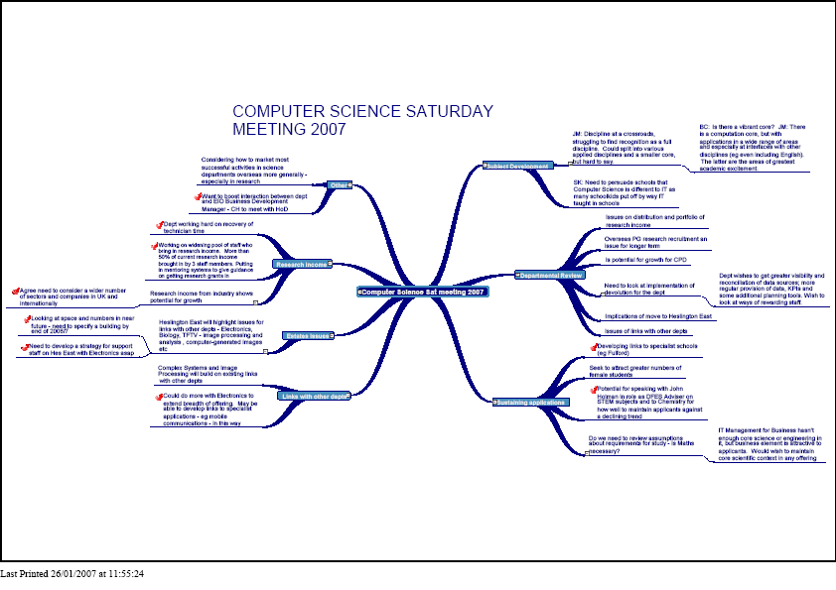
This doesn’t work

Slide 8
Avoid distracting backgrounds
And excessively complicated slide designs

Slide 9
Just because Microsoft
Provides it, doesn’t mean it’s a good thing
For instance avoid the flying bullet
It just irritates the audience…

Slide 10
A little bit of decoration is OK
If you really fancy it (Arial)
Different fonts make a difference too (Times New Roman)
San serif fonts like Arial, Helvetica and Verdana are clear on a screen

Slide 11
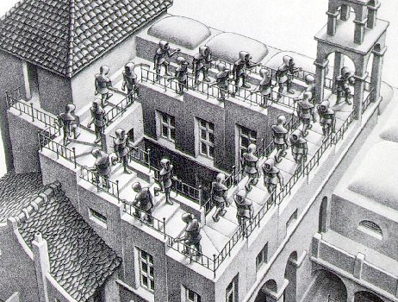
Rehearse and repeat … it will get better!

Slide 12
Referencing

Slide 13
The importance of good referencing
Makes your report look more professional
Shows you have done your background research
Protects you from allegations of plagiarism

Slide 14
Poor referencing
At the very least, just throws away about 5% of your marks
But may have other negative consequences
… it’s not rocket science
… just do it
… and start doing it early in preparing your report, not right at the end when you should be worrying about writing a good conclusion…

Slide 15
Referencing in York CS Dept
Numerous styles of referencing used in computer science, which can cause confusion!
From 10/09, Departmental guidance is to use ‘IEEE style’
But our aim is consistency, rather than dogmatism/pedantry: you are unlikely to be (severely) punished for consistent use of the ‘wrong’ style!

Slide 16
IEEE style
“IEEE Style uses a notational method of referencing when referring to a source of information within the text of a document. In its simplest form, a citation is given consisting of a number enclosed by square brackets. The full details of the source are given in a numerical reference list at the end of the document.” [1]
More details shortly …

Slide 17
An alternative: Harvard
In text citation given by Name and Year: [King 2009]. Full details in Reference List.
If the reader is familiar with the area, may recognize the reference immediately, no need to check the Reference List
Easier to remember if it is cited more than once
However, it takes more space in the text, so not used by journals such as Nature
Not very good when you don’t have an author (e.g., web pages…)

Slide 18
How to do IEEE - in-text citation
A number in square brackets, e.g. [1] or [26], goes in the text, to indicate the relevant reference.
Each citation corresponds to a unique numbered reference which is listed at the end of the document (Reference List). This reference contains all the publication information about the source.
Citations are numbered in the order in which they appear in the text. Once a source has been cited, the same number is used in all the subsequent in-text citations

Slide 19
How to do IEEE - in-text citation
Each reference number should be enclosed in square brackets at the same level as the text, before any punctuation, with a space before the bracket.
Here are some examples:
  "...end of the line for my research [13]."
  "The theory was first put forward in 1987 [1]."
  "Scholtz [2] has argued that......."
  "Several recent studies [3, 4, 15, 16] have suggested that..."
  "For example, see [7]."

Slide 20
How to do IEEE - in-text citation
It is not necessary to say " in reference [26] ..." "In [26] ..." is sufficient.
Citing more than one reference at a time:
Preferred
  [1], [3], [5]
  [1] - [5]
Acceptable
  [1, 3, 5]
  [1-5]

Slide 21
Bibliography vs Reference List
In some disciplines, there’s an important distinction between the Bibliography and the Reference List:
  Bibliography = all the sources that have been read and influenced the author in some way
  Reference List = all sources explicitly cited
In CS, we use the concept of Reference List even if we call it “Bibliography”

Slide 22
Reference List (IEEE)
References must be listed in the order they were cited (numerical order). The references must not be in alphabetical order.
The bracketed number should be on the line, and the lines of each entry indented.
List only one reference per bracketed number.
Footnotes should not be included in the reference list.

Slide 23
Upper or lower case
Every (important) word in the title of a book must be capitalized.
Every (important) word in the title of a journal or conference must be capitalized.
Capitalize only the first word of an article title (except for proper nouns, acronyms, etc.)
Capitalize only the first word of a paper, thesis, or book chapter.
Capitalize the "v" in volume for a book title, but not for a periodical.

Slide 24
Miscellaneous
Punctuation: goes inside the quotation marks.
  Example below with question mark under periodicals.
Abbreviations
  Either spell out the entire name of each periodical you reference or use accepted abbreviations. Be consistent.
  Either spell out words such as volume, December, etc., or abbreviate all occurrences. Be consistent.
  Don’t need to abbreviate March, May, June, July.
  Page range: pp. 111-222. One page only: p. 111.
Spacing: note the correct spacing and punctuation for author names:
  D. L. Tao, C. Siva Ram Murthy, and S. Al Kuran
  but
  T.-C. Hsu and L. A. Stein-Rosenberg

Slide 25
Books
[#] A. A. Author/editor, Title: Subtitle (in italics), Edition(if not the first), Vol.(if a multivolume work). Place of publication: Publisher, Year, page number(s) (if appropriate).
Multiple authors: write out up to 6 authors, or use ‘et al’ after 1st if more than 6

Slide 26
Books: examples
[1] S. M. Hemmingsen, Soft Science. Saskatoon: University of Saskatchewan Press, 1997.
[2] A. Rezi and M. Allam, "Techniques in array processing by means of transformations," in Control and Dynamic Systems, Vol. 69, Multidimensional Systems, C. T. Leondes, Ed. San Diego: Academic Press, 1995, pp. 133-180.
[3] D. Sarunyagate, Ed., Lasers. New York: McGraw-Hill, 1996.

Slide 27
Parts of a book
[#] A. A. Author of Part, "Title of chapter or part," in Title: Subtitle of book, Edition, Vol., A. Editor Ed. Place of publication: Publisher, Year, pp. inclusive page numbers.
[2] G. O. Young, "Synthetic structure of industrial plastics," in Plastics, 2nd ed., vol. 3, J. Peters, Ed. New York: McGraw-Hill, 1964, pp. 15-64.
[3] N. Osifchin and G. Vau, "Power considerations for the modernization of telecommunications in Central and Eastern European and former Soviet Union (CEE/FSU) countries," in Second International Telecommunications Energy Special Conference, 1997, pp. 9-16.

Slide 28
Journal articles
[#] A. A. Author of article. "Title of article," Title of Journal, vol. #, no. #, pp. page number/s, Month year.
[1] E. P. Wigner, "Theory of traveling wave optical laser," Phys. Rev., vol. 134, pp. 635-646, Dec. 1965.
[2] J. U. Duncombe, "Infrared navigation - Part I: An assessment of feasability," IEEE Trans. Electron. Devices, vol. ED-11, pp. 34-39, Jan. 1959.

Slide 29
Electronic documents
Try to describe an electronic source just as you would describe a similar printed publication. If possible, give sufficient information for your readers to retrieve the source themselves.
If page numbers are not given, use paragraph or other section numbers if you need to be specific.
An electronic source may not always contain clear author or publisher details.
The access information will usually be just the URL of the source. As well as a publication/revision date (if there is one), the date of access is often included since an electronic source may change between the time you cite it and the time it is accessed by a reader.

Slide 30
E-journals
[#] A. Author, "Title of Article," Title of Journal, vol., no., p. page numbers, month year. [Format]. Available: Database Name (if appropriate), internet address. [Accessed date of access].
[1] A. Holub, "Is software engineering an oxymoron?" Software Development Times, p. 28, March 2005. [Online]. Available: ProQuest, http://il.proquest.com. [Accessed May 23, 2005].
[2] A. Altun, "Understanding hypertext in the context of reading on the web: Language learners' experience," Current Issues in Education, vol. 6, no. 12, July 2003. [Online]. Available: http://cie.ed.asu.edu/volume6/number12/. [Accessed Dec. 2, 2004].

Slide 31
Web pages / internet documents
[#] A. Author, "Document title," Webpage name, Source/production information, Date of internet publication. [Format]. Available: internet address. [Accessed: Date of access].
[1] G. Sussman, "Home page - Dr. Gerald Sussman," July 2002. [Online]. Available: http://www.comm.pdx.edu/faculty/Sussman/sussmanpage.htm [Accessed: Sept. 12, 2004].
[2] J. Geralds, "Sega Ends Production of Dreamcast," vnunet.com, para. 2, Jan. 31, 2001. [Online]. Available: http://nl1.vnunet.com/news/1116995. [Accessed: Sept. 12, 2004].

Slide 32
Lots of good online guides
For instance you can look at:
http://library.leeds.ac.uk/referencing
www.learnhigher.org.uk
library.curtin.edu.au/research_and_information_skills/referencing

